Slide 1
Neural Networks and Deep learning (DNN)
Architecture of DNN
Layers: input, hidden, output
Perceptron
Multi Layer Perceptron (MLP), Convolution Neural Networks, other Neural Networks
Activation functions: ReLu, Sigmoid, Softmax
Workflow of Neural Networks
Data acquisition and processing
Model building (parameters, hyperparameters, loss, optimization)
Train the model (Training dataset, Python, Numpy, Tensorflow, Pytorch)
Evaluate the model (Test dataset, fine tune the model, make predictions)
Save and Load the model
3. Modes of Learning
Supervised
Unsupervised
Semi-supervised
Reinforcement

Slide 2
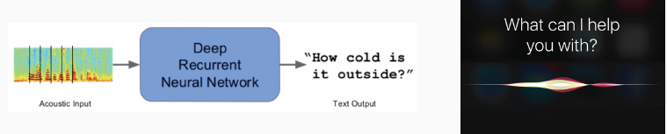

Neural Networks and Deep Learning Models
Neural Networks and DNN models are ubiquitous; they are providing breakthrough results in many applications in the sciences, engineering, social sciences, and in industry.
Speech recognition
Machine translation
Image analysis
Audio synthesis
Question answering

Slide 3
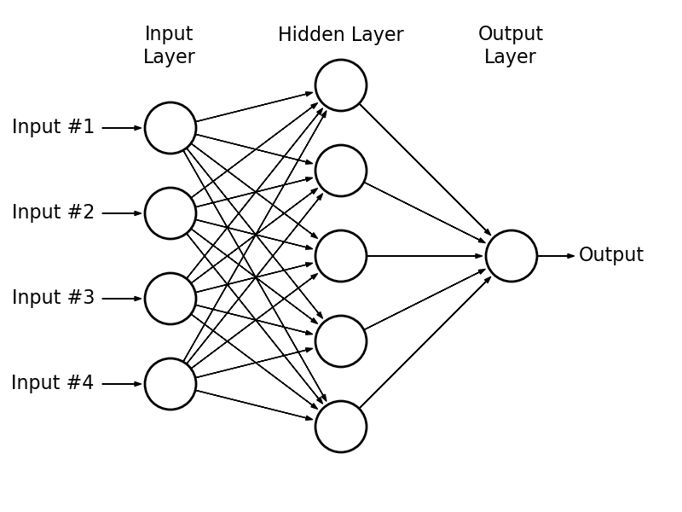
NN Modeling
Neural networks are representations of functions whose input is any sort of data that can be transformed into datasets of numbers and whose output is a sort of prediction or estimation of classes of objects. Neural networks are composed of 3 main types of layers, the input layer, the hidden layer(s), and the output layer.
The input layer is where data is fed into the network.
The hidden Layer(s) where the data is processed.
The output layer where the result of the processed data is obtained.

Slide 4
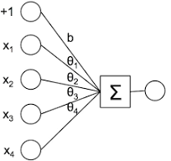
Architecture of Regression Models
Regression model architecture in machine learning involves understanding the relationships between variables to predict a continuous target variable, using linear, polynomial, logistic or other regression models (Ridge, Lasso, Gradient Boosting, KNN etc…), each with its own strengths and weaknesses.
Data Collection and Preparation:
Gather Data:
Collect relevant data for both independent (predictor) and dependent (target) variables.
Data Cleaning:
Handle missing values, outliers, and inconsistencies in the data.
Data Transformation:
Apply necessary transformations (scaling, normalization) to improve model’s performance
Feature Engineering:
Create new features or modify existing ones to enhance the model’s predictive power.
Architecture of Linear Regression:
Inputs have 4 features

Slide 5
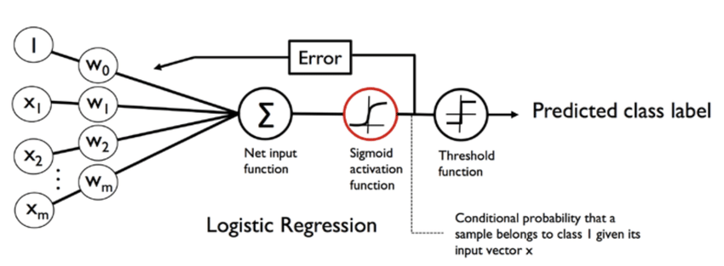
Architecture of Regression Models
2. Model Selection and Refinement:
Choose a Model: Select an appropriate regression model based on the nature of the data and problem to solve.
Linear
Polynomial
Logistic
Others
Model Training: Train the chosen model on a portion of the data (training set)
Model Evaluation: Evaluate the model’s performance on a separate validation set (using metric like MSE, MAE, etc.).
Model Refinement: If necessary, adjust the model parameters or try different models to improve performance.
Architecture of Logistic Regression Model: Binary Class Predictions
3. Model Validation:
Final Evaluation: Evaluate the model on a held-out test set (data not used for training or validation) to assess its ability to generalize.
Interpret Results: Analyze the model’s coefficients, relationships, and predictions to gain insight into the data.
Deployment: Deploy the model for making predictions on new, unseen data

Slide 6
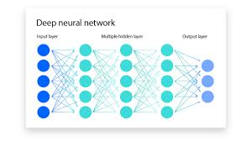
Architecture of Classification Models
Classification model architecture depends on the type of data used and the problem to be solved using that data. However, they all have layers that learn features (hidden layer(s)) and use a final layer to make predictions such as sigmoid layer (binary classification) or softmax layer for multi-class classification.
Multi-Layer Perceptron (MLP)
Structure: Models typically have an input layer, one or more hidden layers, and an output layer.
Function: Input layer receives data, the hidden layers perform non-linear transformations, and the output layer produces predictions by way of probability distribution for each class.
Applications: Good for various classification tasks, especially with structured data.

Slide 7
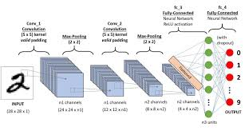
Convolution Neural Networks (CNN)
2. Convolution Neural Networks (CNN)
Structure:
Convolution Layers filters (kernels)
Pooling Layers (creating feature maps)
Fully Connected Layers connections all
Output Layer to produce prediction
Input Layer to receive input data (images)
Function:
CNNs use convolution layers to extract features from the input (creating feature maps). Pooling layers down sample the feature maps to reduce spatial size and computational cost (max pooling). Fully connected layers for classification.
Examples: LeNet, ResNet, VGG, AlexNet
Applications: Image recognition, object detection, other computer vision tasks.

Slide 8
Other Neural Networks
3. Recurrent Neural Networks (RNNs):
Structure: designed for processing sequential data, such as text or time series.
Function: they use recurrent connections to maintain a memory of the input sequence, allowing them to learn dependencies over time.
Examples: Long Short-term Memory (LSTM)
Applications: Natural language processing, speech recognition, and time series analysis.
4. Support Vector Machines (SVMs):
Structure: Used to find the optimal hyperplane that separates different classes.
Function: they map data into a higher-dimensional space and use a linear or non-linear kernel to find the best separation.
Applications: text classification, image classification, and other machine learning tasks.
5. Decision Trees and Random Forests:
Structure: decision trees use tree-like structure to make predictions, random forests combine multiple decision trees to improve accuracy.
Function: they learn rules from the data to classify instances.
Applications: Classification, regression, and other machine learning tasks.

Slide 9
More Common Neural Networks
6. Naïve Bayes:
Structure: probabilistic classifiers based on Baye’s theorem with a strong (naïve) assumption of independence between features.
Function: they calculate the probability of a class given the features and predict the class with the highest probability.
Applications: Text classification, spam filtering, and other tasks where feature independence is a reasonable assumption.
7. Transformers:
Structure: they are based on the attention mechanism, which allows them to focus on relevant parts of the input.
Function: they use self-attention to capture long-range dependencies in the data.
Examples: BERT, GPT.
Applications: Natural language processing, machine translation, and other tasks where context is important.

Slide 10
Workflow of Regression Models
The workflow for building and using a regression model consists of defining the problem, collecting and preparing data, choosing a regression method, fitting and evaluating the model, and interpreting and communicating the results.
1. Define the Problem and Objectives:
Identify the question: what needs to be predicted or to be understood using regression?
Define the dependent variable (target variable): what variable needs to be predicted?
Identify the independent variable(s) (features): what factors influence the target variable?
2. Data Collection and Preparation:
Gather data: collect relevant data for both the dependent and independent variables.
Clean and preprocess the data: handle missing values (features), outliers, and inconsistencies.
Transform the data: consider scaling the data values, normalizing the data values, or using other transformation tools as needed. Encode categorical data, split and balance the dataset.
3. Choose a Regression Model:
Select the appropriate model: choose a linear regression, logistic regression, polynomial regression, or other suitable model based on the nature of the data and the problem (Ridge, Lasso, Quantile, Elastic net, Gradient Boosting, etc.).
Consider model assumptions: understand the assumptions of the chosen model (linearity, independence of errors)

Slide 11
4. Model Fitting and Evaluation:
Split the data: divide the data into training and testing/validation sets.
Train the model: use the training dataset to fit the regression model.
Evaluate the model: assess the model’s performance using metrics like MSE, MAE, R-squared, other relevant metrics.
Refine the model: if necessary, adjust the model (hyperparameters like number of hidden layers, number of neurons in each layer, learning rate, activations …), features, or parameters based on the evaluation results.
5. Interpretation and Communication:
Interpret the results: understand the relationships between the independent and dependent variables.
Communicate findings: present the results in a clear and concise manner, including visualizations and key insights.
Make predictions: use the trained model to predict values for new data.

Slide 12
Hyperparameters in Regression Models
Tuning hyperparameters is crucial for optimizing model performance and preventing overfitting or underfitting.
Common Hyperparameters in Regression Models:
Regularization Strength (Alpha): it controls the trade-off between model complexity and generalization in regularization techniques like Ridge and Lasso regression.
Learning Rate: it determines the step size during optimization (during gradient descent).
Number of Iterations: it specifies how many times the model iterates over the data to refine its learning
parameters.
Polynomial Degree (for Polynomial Regression): it determines the complexity of the polynomial function used to model the relationship between independent and dependent variables.
Batch Size: the number of data points used in each training iteration.
Epochs: the number of times the entire dataset is passed through the model during training.

Slide 13
Workflow of Classification Models
The workflow for building a classification model typically involves data collection, data preparation, model selection, training, evaluating, and deploying (with potentially ongoing maintenance).
1.Data Collection and Preparation:
Identify the problem: clearly define the classification task and the target variable to be predicted.
Gather data: collect relevant data, ensuring it is representative and sufficient for training and testing.
Data cleaning and preprocessing: handle missing values, outliers, and inconsistencies, and transform data into a suitable format for modeling.
Feature engineering: collect or select relevant features that will help the model make accurate predictions.
Split the data: divide the dataset into training (~80%), validation (optional), testing (~20%).
2. Model Selection and Training:
Choose an algorithm: select and appropriate classification algorithm based on the problem type and data characteristics (logistic regression, decision trees, support vector machines, etc.)
Train the model: use the training data to train the chosen algorithm, allowing it to learn relationships between features and target variable.
Tune the hyperparameters: optimize the model’s hyperparameters to improve performance.

Slide 14
3. Evaluation and refinement:
Evaluate the model: assess the model’s performance on the test set (or the validation set) using appropriate metrics (accuracy, precision, recall, F1-score).
Refine the model: if the model’s performance is not satisfactory, adjust hyperparameters, try different algorithm, improve data preparation etc.
4. Deployment and Maintenance:
Deploy the model: integrate the model into a production environment to make predictions on new data.
Monitor and maintain: continuously monitor the model’s performance and retrain it periodically to ensure it remains accurate and relevant.

Slide 15
Hyperparameters for Classification Models
Hyperparameters are settings that control the learning process of a machine learning model, unlike parameters that are learned during training.
Hyperparameters are external configuration variables that data scientists use to manage machine learning model training. They are set before the training process begins and influence how the model learns.
Hyperparameters can significantly impact how ell the model trains and generalizes.
The goal of hyperparameter tuning is to find the values that lead to the best performance on a given task.
Examples of Hyperparameters in Classification Models:
1. Neural Networks:
Number of hidden layers
Number of neurons per layer
Learning rate
Batch size
Activation function
Number of epochs
2. Decision Trees:
Maximum depth of the tree
Minimum number of samples on a leaf
Minimum number of samples to split a node

Slide 16
3. Random Forest:
Number of trees
Number of variables to consider when building each tree
4. Support Vector Machines (SVM):
Kernel function
Regularization parameter
5. k-Nearest Neighbors (kNN):
Number of neighbors (k)
Distance metric

Slide 17
Saving and Loading a Trained Model
To save and load trained a model for inference, it is common to save the model’s learned parameters (states of the model) and load them into an instance of the model when needed for predictions, ensuring to set the model evaluation mode (model.eval()) before inference.
Saving Models for Inference:
When saving a model for inference, we only need to store the learned parameters (weights and biases) of the model’s layers.
In PyTorch, the state_dict is a dictionary that contains the model’s parameters. The dictionary can be saved using torch.save() using .pt or .pth file extensions.
In Tensorflow, a model can be saved using tf.keras.Model.save to store a model’s architecture, weights and biases, and training configuration in a single model.keras zip archive.
Keras models can be saved entirely (including the architecture, weights, biases, optimizer, loss and metric information using model.save() to save models in .keras format which is a zip archive.

Slide 18
Loading Models for Inference:
When loading a saved trained model for inference, it suffices to load the saved learned parameters into a new model instance.
In PyTorch, load the parameters using model.load_state_dict(torch.load(path)) , where path is the path to the saved model file.
In Tensorflow, the entire model is loaded using tf.keras.models.load_model().
With Keras, load the entire model using keras.models.load_model().
Evaluation Mode:
Before running inference on a loaded model, set the model to evaluation mode using model.eval().
This is crucial for layers to function correctly during inference.

Slide 19
Examples
Saving the entire model with Keras:
# Create and train a new model instance
model = create_model()
model.fit(train_images, train_labels, epochs=5)
# Save the entire model as a `.keras` zip archive
model.save('my_model.keras’)
Loading the entire model into a new instance model:
# Load the model from the .keras file
new_model = keras.models.load_model('my_model.keras')
# Check the model architecture
new_model.summary()
# Evaluate the restored model
loss, acc = new_model.evaluate(test_images, test_labels, verbose=2)
print('Restored model, accuracy: {:5.2f}%'.format(100 * acc))

Slide 20
Saving and Loading the Learned Parameters only with Keras:
# Save the model weights
model.save_weights('my_model_weights.ckpt’)
# Create a new model instance
new_model = create_model()
# Load the saved weights
new_model.load_weights('my_model_weights.ckpt')
# Evaluate the model
loss, acc = new_model.evaluate(test_images, test_labels, verbose=2)
print('Restored model, accuracy: {:5.2f}%'.format(100 * acc))

Slide 21
Saving the Weights with Tensorflow:
# Define a simple sequential model
def create_model():
model = tf.keras.Sequential([
keras.layers.Dense(512, activation='relu', input_shape=(784,)),
keras.layers.Dropout(0.2),
keras.layers.Dense(10)
])
model.compile(optimizer='adam',
loss=tf.keras.losses.SparseCategoricalCrossentropy(from_logits=True),
metrics=[tf.keras.metrics.SparseCategoricalAccuracy()])
return model
# Create a model instance
model = create_model()
# Save the weights
model.save_weights('my_model_weights.h5’)
Loading the Weights with Tensorflow
# Create a new model instance
model = create_model()
# Load the weights
model.load_weights('my_model_weights.h5')
# Evaluate the model
loss, acc = model.evaluate(test_images, test_labels, verbose=2)
print(f"Restored model, accuracy: {acc*100:.2f}%")

Slide 22
Saving the states of a model with PyTorch:
import torch
# Assuming `model` is your trained model
model_path = 'model.pth’
torch.save(model.state_dict(), model_path)
Loading the states of a model with PyTorch:
import torch import torch.nn as nn
# Assuming `MyModel` is your model class
class MyModel(nn.Module):
def __init__(self):
super(MyModel, self).__init__()
# Define your model layers here
def forward(self, x):
# Define the forward pass
return x
# Create an instance of the model
model = MyModel()
# Load the state dictionary
model_path = 'model.pth’
model.load_state_dict(torch.load(model_path))
# Set the model to evaluation mode
model.eval()

Slide 23
Modes of Learning
The primary modes of learning in machine learning are supervised, unsupervised, and reinforcement learning, each with distinct approaches to learning from data.
1. Supervised Learning:
Algorithms learn from labeled data to make predictions or classify new data.
Example: predicting house prices based on features like size, location, and number of bedrooms.
Algorithms: linear regression, logistic regression, decision trees, convolution neural network, random forest, support vector machines.
2. Unsupervised Learning:
Algorithms analyze unlabeled data to discover patterns, group similar data, or reduce dimensions.
Example: customer segmentation based on purchasing behavior.
Algorithms: Clustering (k-means), dimensionality reduction (Principal Component Analysis)
3. Reinforcement Learning:
Algorithms learn through trial and error by interacting with the environment to maximize rewards.
Example: training a robot to navigate a maze.
Algorithms: Q-Learning, SARSA.

